Slide 1

Comparing ApprovalTests
With @LlewellynFalco
ApprovalTests is a Free & Open Source Verification Library

Slide 2
ApprovalTests
ApprovalTests is a Free & Open Source Verification Library
Assert.AreEqual(message, "Hello"); // regular assert
message.Should().Be("Hello"); // fluent assert
Approvals.Verify(message); // approval assert

Slide 3
ApprovalTests
ApprovalTests is a Free & Open Source Verification Library
ApprovalTests.Java
Approvals.ruby
ApprovalTests.Net
ApprovalTests.Objective-C
ApprovalTests.perl
go-approval-tests
Approvals.NodeJS
ApprovalTests.Php
ApprovalTests.cpp
github.com/approvals
ApprovalTests.Python

Slide 4
// Create side (0,0) – (3,4)
// Verify length
Whiteboard
English
Testing Circle
Result
Code
Side (0,0) – (3,4) length = 5
Side s = new Side(0,0,3,4);
Approvals.Verify(s + “ length = “ +s.Length);

Slide 5
Merging Excel Data
Customer data.csv
Customer Number, First name, last name, ….
Customer {
"number": 12,
"frist_name": "Sam",
"last_name": "Gamgee",
"orders": [{
"order_number": 1,
"items": ["Ale", "Honey", "Mushrooms"],
"shipments": [{
"tracking_number": "14FVZ3294",
"cost": 15.40,
"ship_date": "2008-01-10T11:00:00-05:00"
}]
}]
}
Order data.csv
Order Number, Customer Number, item 1, item 2 …
Combine
Shipment data.csv
Order Number, shipping method, cost, tracking number,

Slide 6
Numbers or Short Text
Roman Numerals
1 is I

Slide 7
ApprovalTests in Java
ApprovalTests is a Free & Open Source Verification Library
RomanNumeralTest.java
RomanNumeralTest.java
@Test
public void test1() throws Exception {
assertEquals(”I", RomanNumerals.convert(1));
}
@Test
public void test1() throws Exception {
Approvals.verify(RomanNumerals.convert(1));
}
+
I
RomanNumeralTest.test1.approved.txt

Slide 8
ApprovalTests in Java
ApprovalTests is a Free & Open Source Verification Library
RomanNumeralTest.java
RomanNumeralTest.java
@Test
public void test1() throws Exception {
assertEquals(”I", RomanNumerals.convert(1));
}
@Test
public void test1() throws Exception {
Approvals.verify("RomanNumerals \n\n 1 => " +
RomanNumerals.convert(1));
}
+
RomanNumerals
1 => I
RomanNumeralTest.test1.approved.txt

Slide 9
ApprovalTests in Java
ApprovalTests is a Free & Open Source Verification Library
RomanNumeralTest.java
RomanNumeralTest.java
@Test
public void test1() throws Exception {
Integer[] numbers = { 1 };
Approvals.verifyAll("RomanNumerals",
numbers,
n -> n + " => " + RomanNumerals.convert(n));
}
@Test
public void test1() throws Exception {
assertEquals(”I", RomanNumerals.convert(1));
}
+
RomanNumerals
1 => I
RomanNumeralTest.test1.approved.txt

Slide 10
CODE

Slide 11
Numbers or Short Text
Roman Numerals
1 is I
2 is II

Slide 12
ApprovalTests in Java
ApprovalTests is a Free & Open Source Verification Library
RomanNumeralTest.java
RomanNumeralTest.java
@Test
public void testConvert() throws Exception {
Integer[] numbers = { 1,2 };
Approvals.verifyAll("RomanNumerals",
numbers,
n -> n + " => " + RomanNumerals.convert(n));
}
@Test
public void test1() throws Exception {
assertEquals(”I", RomanNumerals.convert(1));
}
@Test
public void test2() throws Exception {
assertEquals(”II", RomanNumerals.convert(2));
}
+
RomanNumerals
1 => I
2 => II
RomanNumeralTest.testConvert.approved.txt

Slide 13
CODE

Slide 14
Numbers or Short Text
Roman Numerals
1 is I
2 is II
3 is III

Slide 15
ApprovalTests in Java
ApprovalTests is a Free & Open Source Verification Library
RomanNumeralTest.java
RomanNumeralTest.java
@Test
public void testConvert() throws Exception {
Integer[] numbers = { 1,2,3 };
Approvals.verifyAll("RomanNumerals",
numbers,
n -> n + " => " + RomanNumerals.convert(n));
}
@Test
public void test1() throws Exception {
assertEquals(”I", RomanNumerals.convert(1));
}
@Test
public void test2() throws Exception {
assertEquals(”II", RomanNumerals.convert(2));
}
@Test
public void test3() throws Exception {
assertEquals(”III", RomanNumerals.convert(3));
}
+
RomanNumerals
1 => I
2 => II
3 => III
RomanNumeralTest.testConvert.approved.txt

Slide 16
CODE

Slide 17
Numbers or Short Text
Roman Numerals
1 is I
2 is II
3 is III
4 is IV

Slide 18
ApprovalTests in Java
ApprovalTests is a Free & Open Source Verification Library
RomanNumeralTest.java
RomanNumeralTest.java
@Test
public void test1() throws Exception {
assertEquals(”I", RomanNumerals.convert(1));
}
@Test
public void test2() throws Exception {
assertEquals(”II", RomanNumerals.convert(2));
}
@Test
public void test3() throws Exception {
assertEquals(”III", RomanNumerals.convert(3));
}
@Test
public void test4() throws Exception {
assertEquals(”IV", RomanNumerals.convert(4));
}
@Test
public void testConvert() throws Exception {
Integer[] numbers = Range.get(1, 4);
Approvals.verifyAll("RomanNumerals",
numbers,
n -> n + " => " + RomanNumerals.convert(n));
}
+
RomanNumerals
1 => I
2 => II
3 => III
4 => IV
RomanNumeralTest.testConvert.approved.txt

Slide 19
CODE

Slide 20
Numbers or Short Text
Roman Numerals
1 is I
2 is II
3 is III
4 is IV
5 is V

Slide 21
ApprovalTests in Java
ApprovalTests is a Free & Open Source Verification Library
RomanNumeralTest.java
RomanNumeralTest.java
@Test
public void test1() throws Exception {
assertEquals(”I", RomanNumerals.convert(1));
}
@Test
public void test2() throws Exception {
assertEquals(”II", RomanNumerals.convert(2));
}
@Test
public void test3() throws Exception {
assertEquals(”III", RomanNumerals.convert(3));
}
@Test
public void test4() throws Exception {
assertEquals(”IV", RomanNumerals.convert(4));
}
@Test
public void test5() throws Exception {
assertEquals(”V", RomanNumerals.convert(5));
}
@Test
public void testConvert() throws Exception {
Integer[] numbers = Range.get(1, 5);
Approvals.verifyAll("RomanNumerals",
numbers,
n -> n + " => " + RomanNumerals.convert(n));
}
+
RomanNumerals
1 => I
2 => II
3 => III
4 => IV
5 => V
RomanNumeralTest.testConvert.approved.txt

Slide 22
CODE

Slide 23
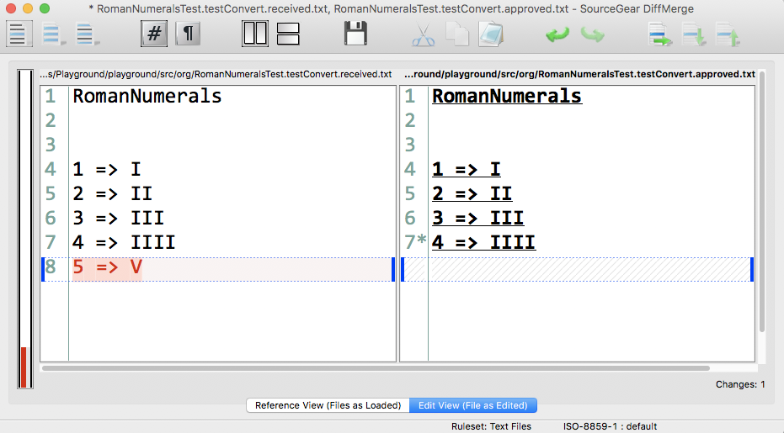

Slide 24
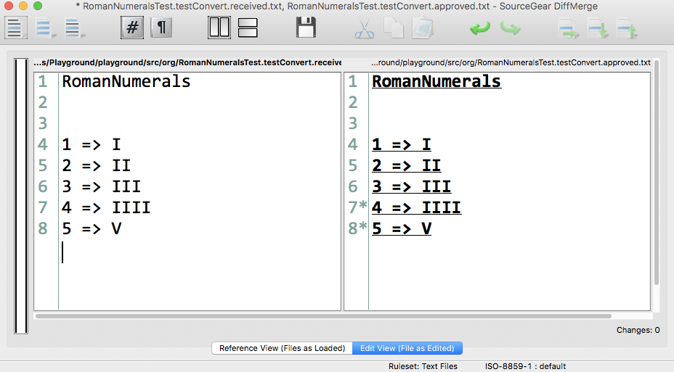

Slide 25
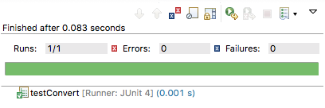

Slide 26
Numbers or Short Text
Roman Numerals
1 is I
2 is II
3 is III
4 is IV
5 is V
6 is VI
7 is VII
8 is VIII
9 is IX
10 is X
11 is XI
12 is XII
13 is XIII
14 is XIV
15 is XV
16 is XVI
17 is XVII
18 is XVIII
19 is XIX
20 is XX

Slide 27
ApprovalTests in Java
ApprovalTests is a Free & Open Source Verification Library
RomanNumeralTest.java
@Test
public void test1() throws Exception {
assertEquals("I", RomanNumerals.convert(1));
}
@Test
public void test2() throws Exception {
assertEquals("II", RomanNumerals.convert(2));
}
@Test
public void test3() throws Exception {
assertEquals("III", RomanNumerals.convert(3));
}
@Test
public void test4() throws Exception {
assertEquals("IV", RomanNumerals.convert(4));
}
@Test
public void test5() throws Exception {
assertEquals("V", RomanNumerals.convert(5));
}
@Test
public void test6() throws Exception {
assertEquals("VI", RomanNumerals.convert(6));
}
@Test
public void test7() throws Exception {
assertEquals("VII", RomanNumerals.convert(7));
}
@Test
public void test8() throws Exception {
assertEquals("VIII", RomanNumerals.convert(8));
}
@Test
public void test9() throws Exception {
assertEquals("IX", RomanNumerals.convert(9));
}
@Test
public void test10() throws Exception {
assertEquals("X", RomanNumerals.convert(10));
}
@Test
public void test11() throws Exception {
assertEquals("XI", RomanNumerals.convert(11));
}
@Test
public void test12() throws Exception {
assertEquals("XII", RomanNumerals.convert(12));
}
@Test
public void test13() throws Exception {
assertEquals("XIII", RomanNumerals.convert(13));
}
@Test
public void test14() throws Exception {
assertEquals("XIV", RomanNumerals.convert(14));
}
@Test
public void test15() throws Exception {
assertEquals("XV", RomanNumerals.convert(15));
}
@Test
public void test16() throws Exception {
assertEquals("XVI", RomanNumerals.convert(16));
}
@Test
public void test17() throws Exception {
assertEquals("XVII", RomanNumerals.convert(17));
}
@Test
public void test18() throws Exception {
assertEquals("XVIII", RomanNumerals.convert(18));
}
@Test
public void test19() throws Exception {
assertEquals("XIX", RomanNumerals.convert(19));
}
@Test
public void test20() throws Exception {
assertEquals("XX", RomanNumerals.convert(20));
}
RomanNumeralTest.java
@Test
public void testConvert() throws Exception {
Integer[] numbers = Range.get(1, 20);
Approvals.verifyAll("RomanNumerals",
numbers,
n -> n + " => " + RomanNumerals.convert(n));
}
+
RomanNumerals
1 => I
2 => II
3 => III
4 => IV
5 => V
6 => VI
7 => VII
8 => VIII
9 => IX
10 => X
11 => XI
12 => XII
13 => XIII
14 => XIV
15 => XV
16 => XVI
17 => XVII
18 => XVIII
19 => XIX
20 => XX
RomanNumeralTest.testConvert.approved.txt

Slide 28
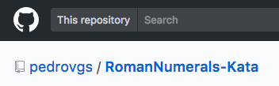
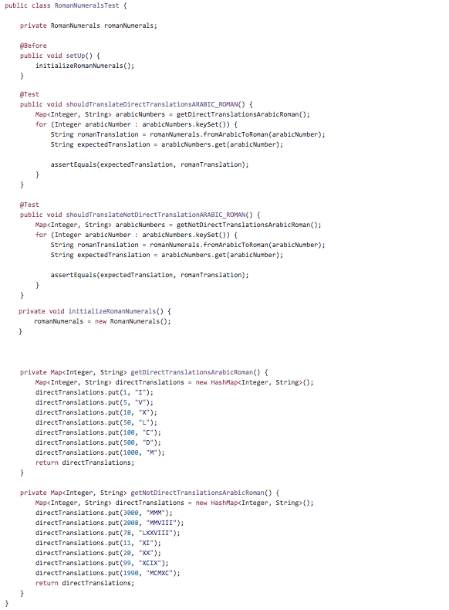
ApprovalTests in Java
ApprovalTests is a Free & Open Source Verification Library
RomanNumeralTest.java
RomanNumeralTest.java
@Test
public void testConvert() throws Exception {
Integer[] numbers = Range.get(1, 4999);
Approvals.verifyAll("RomanNumerals",
numbers,
n -> n + " => " + RomanNumerals.convert(n));
}
+
1
5
10
50
100
500
1000
3000
2008
78
11
20
99
1990
RomanNumerals
1 => I
2 => II
3 => III
4 => IV
5 => V
6 => VI
7 => VII
8 => VIII
9 => IX
10 => X
11 => XI
12 => XII
13 => XIII
14 => XIV
15 => XV
16 => XVI
17 => XVII
18 => XVIII
19 => XIX
20 => XX
RomanNumeralTest.testConvert.approved.txt

Slide 29
Conway’s game of Life

Slide 30
// Create side (0,0) – (3,4)
// Verify length
Whiteboard
English
Testing Circle
Result
Code
Side (0,0) – (3,4) length = 5
Side s = new Side(0,0,3,4);
Approvals.Verify(s + “ length = “ +s.Length);

Slide 31
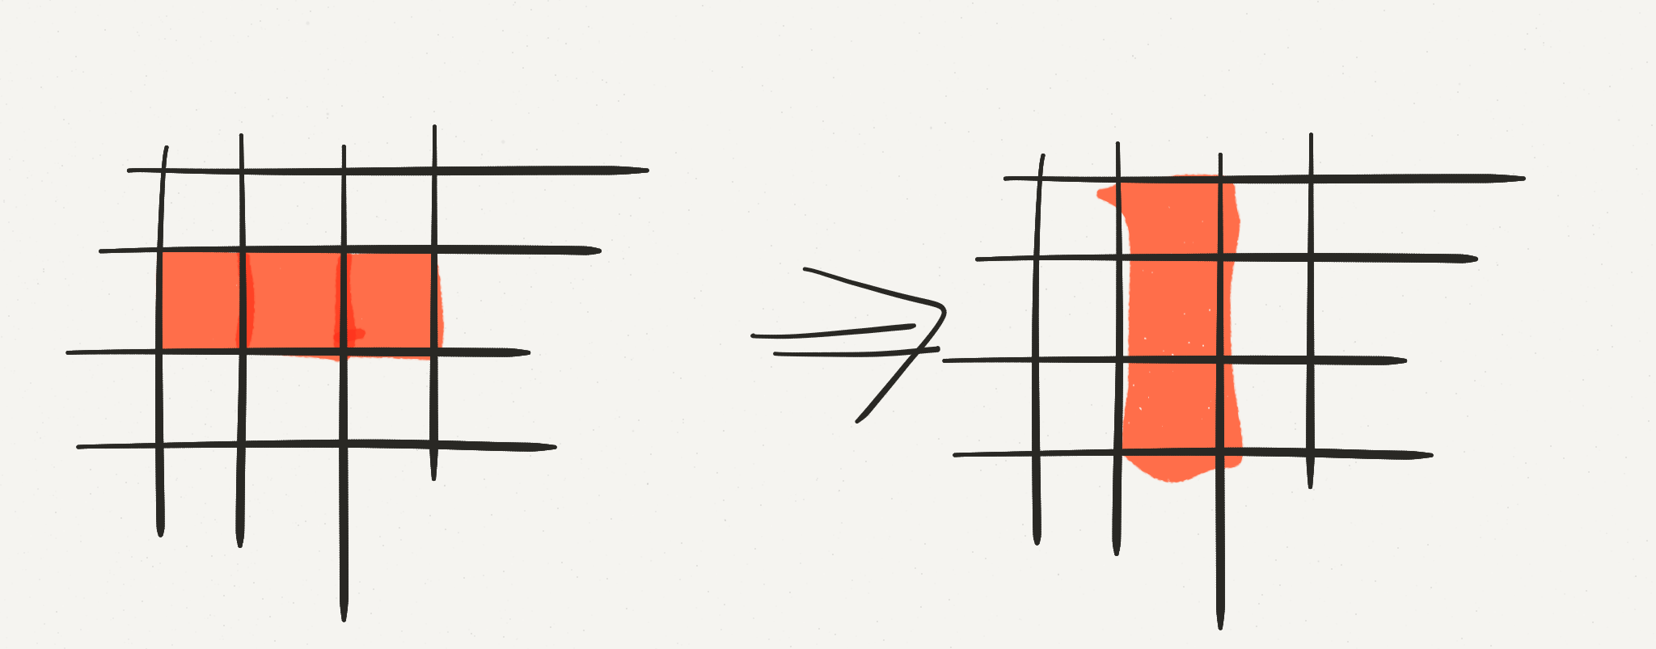
ToString
Game of Life

Slide 32
ToString
Game of Life
Create a board.
Populate cell (0,1)
Populate cell(1,1)
Populate cell (2,1)
Advance to the next Turn
Verify the board

Slide 33
ApprovalTests in .Net
ApprovalTests is a Free & Open Source Verification Library
GameOfLifeTest.cs
[TestMethod]
public void TestBlinker3()
{
var game = new Board(3, 3);
game.PlaceCell(0, 1);
game.PlaceCell(1, 1);
game.PlaceCell(2, 1);
game.AdvanceTurn();
Assert.IsTrue(game.IsCellAlive(new Point(1,0)));
Assert.IsTrue(game.IsCellAlive(new Point(1,1)));
Assert.IsTrue(game.IsCellAlive(new Point(1,1)));
}
GameOfLifeTest.cs
[TestMethod]
public void TestBlinker()
{
var game = new Board(3,3);
game.PlaceCell(0, 1);
game.PlaceCell(1, 1);
game.PlaceCell(2, 1);
game.AdvanceTurn();
Approvals.Verify(game.ToString());
}
+
0 1 2
0 *
1 *
2 *
GameOfLifeTest.TestBlinker.approved.txt

Slide 34
ApprovalTests in .Net
ApprovalTests is a Free & Open Source Verification Library
GameOfLifeTest.cs
[TestMethod]
public void TestBlinker3()
{
var game = new Board(3, 3);
game.PlaceCell(0, 1);
game.PlaceCell(1, 1);
game.PlaceCell(2, 1);
game.AdvanceTurn();
Assert.IsTrue(game.IsCellAlive(new Point(1,0)));
Assert.IsTrue(game.IsCellAlive(new Point(1,1)));
Assert.IsTrue(game.IsCellAlive(new Point(1,1)));
Assert.IsFalse(game.IsCellAlive(new Point(0,1)));
Assert.IsFalse(game.IsCellAlive(new Point(2,1)));
}
GameOfLifeTest.cs
[TestMethod]
public void TestBlinker()
{
var game = new Board(3,3);
game.PlaceCell(0, 1);
game.PlaceCell(1, 1);
game.PlaceCell(2, 1);
game.AdvanceTurn();
Approvals.Verify(game.ToString());
}
+
0 1 2
0 *
1 *
2 *
GameOfLifeTest.TestBlinker.approved.txt

Slide 35
ApprovalTests in .Net
ApprovalTests is a Free & Open Source Verification Library
GameOfLifeTest.cs
[TestMethod]
public void TestBlinker3()
{
var game = new Board(3, 3);
game.PlaceCell(0, 1);
game.PlaceCell(1, 1);
game.PlaceCell(2, 1);
game.AdvanceTurn();
Assert.IsTrue(game.IsCellAlive(new Point(1,0)));
Assert.IsTrue(game.IsCellAlive(new Point(1,1)));
Assert.IsTrue(game.IsCellAlive(new Point(2,1)));
Assert.IsFalse(game.IsCellAlive(new Point(0,1)));
Assert.IsFalse(game.IsCellAlive(new Point(2,1)));
Assert.IsFalse(game.IsCellAlive(new Point(2,0)));
Assert.IsFalse(game.IsCellAlive(new Point(0,0)));
Assert.IsFalse(game.IsCellAlive(new Point(0,2)));
Assert.IsFalse(game.IsCellAlive(new Point(2,2)));
}
GameOfLifeTest.cs
[TestMethod]
public void TestBlinker()
{
var game = new Board(3,3);
game.PlaceCell(0, 1);
game.PlaceCell(1, 1);
game.PlaceCell(2, 1);
game.AdvanceTurn();
Approvals.Verify(game.ToString());
}
+
0 1 2
0 *
1 *
2 *
GameOfLifeTest.TestBlinker.approved.txt

Slide 36
ApprovalTests in .Net
ApprovalTests is a Free & Open Source Verification Library
GameOfLifeTest.cs
[TestMethod]
public void TestBlinker3()
{
var game = new Board(3, 3);
game.PlaceCell(0, 1);
game.PlaceCell(1, 1);
game.PlaceCell(2, 1);
game.AdvanceTurn();
Assert.IsTrue(game.IsCellAlive(new Point(1,0)));
Assert.IsTrue(game.IsCellAlive(new Point(1,1)));
Assert.IsTrue(game.IsCellAlive(new Point(1,1)));
Assert.IsFalse(game.IsCellAlive(new Point(0,1)));
Assert.IsFalse(game.IsCellAlive(new Point(2,1)));
Assert.IsFalse(game.IsCellAlive(new Point(0,0)));
Assert.IsFalse(game.IsCellAlive(new Point(2,0)));
Assert.IsFalse(game.IsCellAlive(new Point(0,0)));
Assert.IsFalse(game.IsCellAlive(new Point(0,2)));
Assert.IsFalse(game.IsCellAlive(new Point(2,2)));
Assert.AreEqual(3, game.Width);
Assert.AreEqual(3, game.Height);
}
GameOfLifeTest.cs
[TestMethod]
public void TestBlinker()
{
var game = new Board(3,3);
game.PlaceCell(0, 1);
game.PlaceCell(1, 1);
game.PlaceCell(2, 1);
game.AdvanceTurn();
Approvals.Verify(game.ToString());
}
+
0 1 2
0 *
1 *
2 *
GameOfLifeTest.TestBlinker.approved.txt

Slide 37
ApprovalTests in .Net
ApprovalTests is a Free & Open Source Verification Library
GameOfLifeTest.cs
[TestMethod]
public void TestBlinker3()
{
var game = new Board(3, 3);
game.PlaceCell(0, 1);
game.PlaceCell(1, 1);
game.PlaceCell(2, 1);
game.AdvanceTurn();
Assert.IsTrue(game.IsCellAlive(new Point(1,0)));
Assert.IsTrue(game.IsCellAlive(new Point(1,1)));
Assert.IsTrue(game.IsCellAlive(new Point(1,1)));
Assert.IsFalse(game.IsCellAlive(new Point(0,1)));
Assert.IsFalse(game.IsCellAlive(new Point(2,1)));
Assert.IsFalse(game.IsCellAlive(new Point(0,0)));
Assert.IsFalse(game.IsCellAlive(new Point(2,0)));
Assert.IsFalse(game.IsCellAlive(new Point(0,0)));
Assert.IsFalse(game.IsCellAlive(new Point(0,2)));
Assert.IsFalse(game.IsCellAlive(new Point(2,2)));
Assert.AreEqual(3, game.Width);
Assert.AreEqual(3, game.Height);
}
GameOfLifeTest.cs
[TestMethod]
public void TestBlinker()
{
var game = new Board(3,3);
game.PlaceCell(0, 1);
game.PlaceCell(1, 1);
game.PlaceCell(2, 1);
var text = "1) \n" + game.ToString() + "\n\n";
game.AdvanceTurn();
text += "2) \n" + game.ToString();
Approvals.Verify(text);
}
+
1)
0 1 2
0
1 * * *
2
2)
0 1 2
0 *
1 *
2 *
GameOfLifeTest.TestBlinker.approved.txt

Slide 38
ToString
Game of Life

Slide 39
ApprovalTests
ApprovalTests is a Free & Open Source Verification Library
Write Test
Write Code

Slide 40
ApprovalTests
ApprovalTests is a Free & Open Source Verification Library
Test
Write Test to create the actual result
Create the expected result
Write Code

Slide 41
ApprovalTests
ApprovalTests is a Free & Open Source Verification Library
Write Test to create the actual result
Write Code
Create the expected result
Test
Approve

Slide 42
ApprovalTests
ApprovalTests is a Free & Open Source Verification Library
Write Test to create the actual result
Write Code
Approve the expected result
Test

Slide 43
Game of Life

Slide 44
ApprovalTests
ApprovalTests is a Free & Open Source Verification Library
1) Specification
2) Feedback
3) Regression
4) Granularity

Slide 45
Game of Life
1) Grid

Slide 46
Game of Life
Grid
Alive

Slide 47
Game of Life
Grid
Alive
Advance turn

Slide 48
Game of Life
Grid
Alive
Advance turn
Neighbors

Slide 49
Game of Life
Grid
Alive
Advance turn
Neighbors
Neighbors 2

Slide 50
Game of Life
Grid
Alive
Advance turn
Neighbors
Neighbors 2 & 3

Slide 51
Game of Life
Grid
Alive
Advance turn
Neighbors
Neighbors 2 & 3
3 Neighbors spawns

Slide 52
Merging Excel Data
Customer data.csv
Customer Number, First name, last name, ….
Customer {
"number": 12,
"frist_name": "Sam",
"last_name": "Gamgee",
"orders": [{
"order_number": 1,
"items": ["Ale", "Honey", "Mushrooms"],
"shipments": [{
"tracking_number": "14FVZ3294",
"cost": 15.40,
"ship_date": "2008-01-10T11:00:00-05:00"
}]
}]
}
Order data.csv
Order Number, Customer Number, item 1, item 2 …
Combine
Shipment data.csv
Order Number, shipping method, cost, tracking number,

Slide 53
Merging Excel Data
Combine customer data, order data and shipment data
Verify the result

Slide 54
Merging Excel Data
Combine customer data, order data and shipment data
Verify the result
[{
"Customer": {
"orders": [{
"shipments": [{
"ship_date": "2008-01-10T11:00:00-05:00",
"cost": "$292.01",
"tracking_number": "58bd4e0e2076c537770610a9"
}, {
"ship_date": "2008-01-10T11:00:00-05:00",
"cost": "$246.34",
"tracking_number": "58bd4e0e0d3a922c8d3205c0"
}],
"status": "shipped",
"items": [
"eu",
"officia",
"dolore",
"tempor"
],
"order_number": "58bd4e0ed05d95922b3f0f29"
}, {
"shipments": [{
"ship_date": "2008-01-10T11:00:00-05:00",
"cost": "$82.16",
"tracking_number": "58bd4e0e8f19bb4e78c35b93"
}],
"status": "pending",
"items": [
"est"
],
"order_number": "58bd4e0e81710e766dacb3f3"
}, {
"shipments": [{
"ship_date": "2008-01-10T11:00:00-05:00",
"cost": "$87.19",
"tracking_number": "58bd4e0ed424430c3cb163e8"
}],
"status": "canceled",
"items": [
"veniam"
],
"order_number": "58bd4e0e8d098ba0c400a768"
}],
"phone": "+1 (865) 501-3598”,
DataImportTest.cs
[TestMethod]
public void TestCombineCustomerData()
{
var results = CustomerData.CombineFiles(
"customer_data.csv",
"order_data.csv",
"shipment_data.csv");
Approvals.VerifyJson(results);
}
+
DataImportTest.TestCombineCustomerData.approved.json

Slide 55
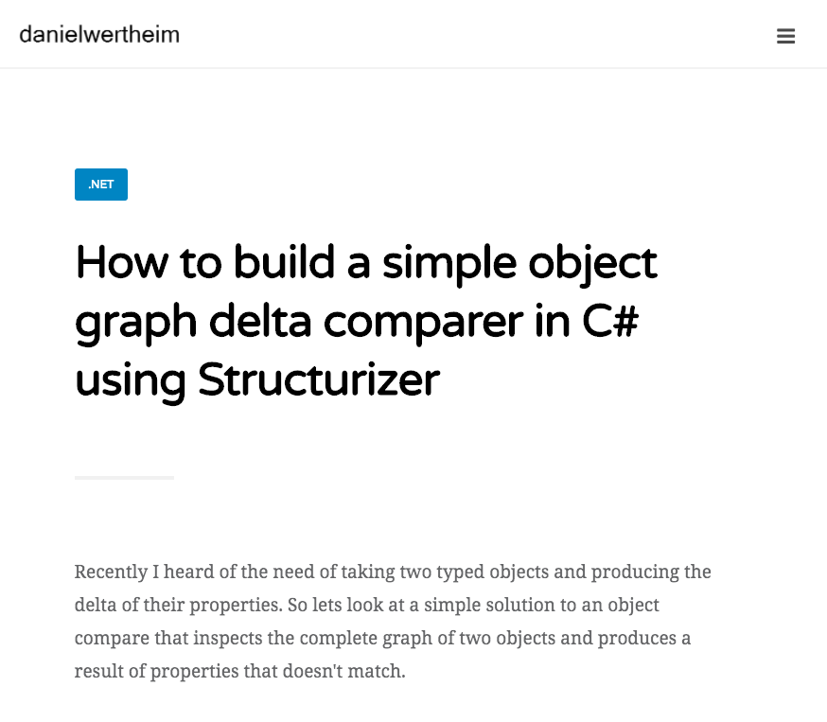
ApprovalTests in .Net
ApprovalTests is a Free & Open Source Verification Library
public void Sample()
{
var a = new Customer
{
FirstName = "Daniel",
LastName = "Andersson",
PrimaryAddress = new Address
{
Street = "Some street 1",
Zip = "11111",
City = "City1",
Country = "Sweden"
},
Tags = new[] { "Test1", "Test3" }
};
var b = new Customer
{
FirstName = "Daniel",
LastName = "Olsson",
PrimaryAddress = new Address
{
Street = "Some street 1",
Zip = "22222",
City = "City2",
Country = "Sweden"
},
Tags = new[] { "Test1", "Test2", "Test3" }
};
var comparer = new ObjectComparer();
var result = comparer.Compare(a, b);
result.Deltas.Count.ShouldBe(4);
result.Deltas[0].Name.ShouldBe("LastName");
result.Deltas[0].A.Value.ShouldBe("Andersson");
result.Deltas[0].B.Value.ShouldBe("Olsson");
result.Deltas[1].Name.ShouldBe("PrimaryAddress.Zip");
result.Deltas[1].A.Value.ShouldBe("11111");
result.Deltas[1].B.Value.ShouldBe("22222");
result.Deltas[2].Name.ShouldBe("PrimaryAddress.City");
result.Deltas[2].A.Value.ShouldBe("City1");
result.Deltas[2].B.Value.ShouldBe("City2");
result.Deltas[3].Name.ShouldBe("Tags");
result.Deltas[3].Path.ShouldBe("Tags[1]");
result.Deltas[3].A.Value.ShouldBe("Test3");
result.Deltas[3].B.Value.ShouldBe("Test2");
}
*https://danielwertheim.se/how-to-build-a-simple-object-graph-delta-comparer-in-csharp-using-structurizer/

Slide 56
ApprovalTests in .Net
ApprovalTests is a Free & Open Source Verification Library
var comparer = new ObjectComparer();
var result = comparer.Compare(a, b);
result.Deltas.Count.ShouldBe(4);
result.Deltas[0].Name.ShouldBe("LastName");
result.Deltas[0].A.Value.ShouldBe("Andersson");
result.Deltas[0].B.Value.ShouldBe("Olsson");
result.Deltas[1].Name.ShouldBe("PrimaryAddress.Zip");
result.Deltas[1].A.Value.ShouldBe("11111");
result.Deltas[1].B.Value.ShouldBe("22222");
result.Deltas[2].Name.ShouldBe("PrimaryAddress.City");
result.Deltas[2].A.Value.ShouldBe("City1");
result.Deltas[2].B.Value.ShouldBe("City2");
result.Deltas[3].Name.ShouldBe("Tags");
result.Deltas[3].Path.ShouldBe("Tags[1]");
result.Deltas[3].A.Value.ShouldBe("Test3");
result.Deltas[3].B.Value.ShouldBe("Test2");
}
Comparing yields:
{
"LastName": 'Andersson' != 'Olsson'
"PrimaryAddress.Zip": '11111' != '22222’
"PrimaryAddress.City": 'City1' != 'City2'
"Tags[1]": 'Test3' != 'Test2'
}
ObjectCompareTest.sample.approved.txt

Slide 57
ApprovalTests in .Net
ApprovalTests is a Free & Open Source Verification Library
var comparer = new ObjectComparer();
var result = comparer.Compare(a, b);
result.Deltas.Count.ShouldBe(4);
result.Deltas[0].Name.ShouldBe("LastName");
result.Deltas[0].A.Value.ShouldBe("Andersson");
result.Deltas[0].B.Value.ShouldBe("Olsson");
result.Deltas[1].Name.ShouldBe("PrimaryAddress.Zip");
result.Deltas[1].A.Value.ShouldBe("11111");
result.Deltas[1].B.Value.ShouldBe("22222");
result.Deltas[2].Name.ShouldBe("PrimaryAddress.City");
result.Deltas[2].A.Value.ShouldBe("City1");
result.Deltas[2].B.Value.ShouldBe("City2");
result.Deltas[3].Name.ShouldBe("Tags");
result.Deltas[3].Path.ShouldBe("Tags[1]");
result.Deltas[3].A.Value.ShouldBe("Test3");
result.Deltas[3].B.Value.ShouldBe("Test2");
}
Comparing:
{
"FirstName": "Daniel",
"LastName": "Andersson",
"PrimaryAddress": {
"Street": "Some street 1",
"Zip": "11111",
"City": "City1",
"Country": "Sweden"
},
"Tags": [
"Test1",
"Test3"
]
}
VS.
{
"FirstName": "Daniel",
"LastName": "Olsson",
"PrimaryAddress": {
"Street": "Some street 1",
"Zip": "22222",
"City": "City2",
"Country": "Sweden"
},
"Tags": [
"Test1",
"Test2",
"Test3"
]
}
yields:
{
"LastName": 'Andersson' != 'Olsson'
"PrimaryAddress.Zip": '11111' != '22222’
"PrimaryAddress.City": 'City1' != 'City2'
"Tags[1]": 'Test3' != 'Test2'
}
ObjectCompareTest.sample.approved.txt

Slide 58
ApprovalTests in .Net
ApprovalTests is a Free & Open Source Verification Library
var comparer = new ObjectComparer();
var result = comparer.Compare(a, b);
result.Deltas.Count.ShouldBe(4);
result.Deltas[0].Name.ShouldBe("LastName");
result.Deltas[0].A.Value.ShouldBe("Andersson");
result.Deltas[0].B.Value.ShouldBe("Olsson");
result.Deltas[1].Name.ShouldBe("PrimaryAddress.Zip");
result.Deltas[1].A.Value.ShouldBe("11111");
result.Deltas[1].B.Value.ShouldBe("22222");
result.Deltas[2].Name.ShouldBe("PrimaryAddress.City");
result.Deltas[2].A.Value.ShouldBe("City1");
result.Deltas[2].B.Value.ShouldBe("City2");
result.Deltas[3].Name.ShouldBe("Tags");
result.Deltas[3].Path.ShouldBe("Tags[1]");
result.Deltas[3].A.Value.ShouldBe("Test3");
result.Deltas[3].B.Value.ShouldBe("Test2");
var comparer = new ObjectComparer();
var result = comparer.Compare(a, b);
Approvals.Verify(
$"Comparing:\n {a}\n\n VS.\n\n {b}\n yields:\n\n{result}");
VerifyObjectComparer(a, b);
Custom Assert

Slide 59
ApprovalTests in .Net
ApprovalTests is a Free & Open Source Verification Library
var a = new Customer
{
FirstName = "Daniel",
LastName = "Andersson",
PrimaryAddress = new Address
{
Street = "Some street 1",
Zip = "11111",
City = "City1",
Country = "Sweden"
},
Tags = new[] { "Test1", "Test3" }
};
var b = new Customer
{
FirstName = "Daniel",
LastName = "Olsson",
PrimaryAddress = new Address
{
Street = "Some street 1",
Zip = "22222",
City = "City2",
Country = "Sweden"
},
Tags = new[] { "Test1", "Test2", "Test3" }
};
VerifyObjectComparer(a, b);
Comparing:
{
"FirstName": "Daniel",
"LastName": "Andersson",
"PrimaryAddress": {
"Street": "Some street 1",
"Zip": "11111",
"City": "City1",
"Country": "Sweden"
},
"Tags": [
"Test1",
"Test3"
]
}
VS.
{
"FirstName": "Daniel",
"LastName": "Olsson",
"PrimaryAddress": {
"Street": "Some street 1",
"Zip": "22222",
"City": "City2",
"Country": "Sweden"
},
"Tags": [
"Test1",
"Test2",
"Test3"
]
}
yields:
{
"LastName": 'Andersson' != 'Olsson'
"PrimaryAddress.Zip": '11111' != '22222’
"PrimaryAddress.City": 'City1' != 'City2'
"Tags[1]": 'Test3' != 'Test2'
}
ObjectCompareTest.cs
ObjectCompareTest.sample.approved.txt

Slide 60
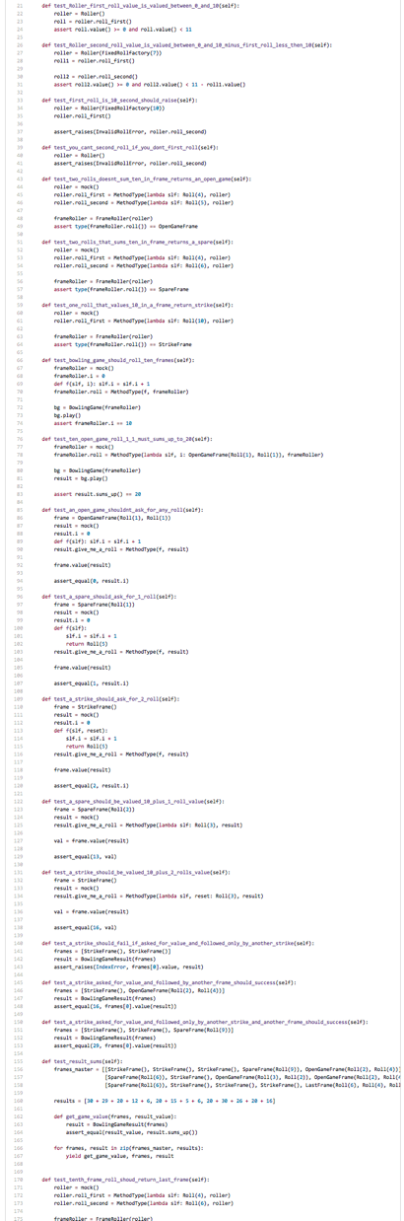
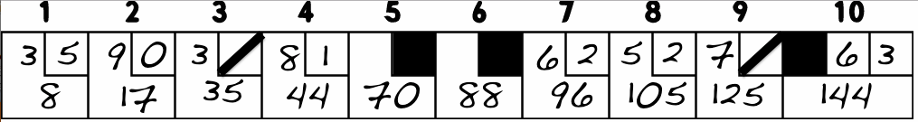
ApprovalTests in Python
ApprovalTests is a Free & Open Source Verification Library
BowlingTest.py
BowlingTest.py
def test_bowling(self): game = Bowling() game.roll( 3, 5, 9, 0, 3, 7, 8, 1,
10, 10, 6, 2, 5,
4, 7, 3, 10, 6, 3) verify(str(game))
+
1) 3, 5 [8] = 8
2) 9, 0 [9] = 17
3) 3, 7 [18] = 35
4) 8, 1 [9] = 44
5) 10 [26] = 70
6) 10 [18] = 88
7) 6, 2 [8] = 96
8) 5, 4 [9] = 105
9) 7, 3 [20] = 125
10) 10, 6, 3 [19] = 144
BowlingTest.test_bowling.approved.txt

Slide 61
ApprovalTests in Python
ApprovalTests is a Free & Open Source Verification Library
BowlingTest.py
BowlingTest.py
def setUp(self): # decided not to inherit from Game to make tests more explicit self.Game_instance = Game() def tearDown(self): del self.Game_instance def _roll_many(self, pins, rolls=20): for frame in range(rolls): self.Game_instance.roll(pins) def test_name_of_class(self): self.assertEqual(self.Game_instance.__class__.__name__, 'Game') def test_gutter_game(self): self._roll_many(0) self.assertEqual(self.Game_instance.score(), 0) def test_all_ones(self): self._roll_many(1) self.assertEqual(self.Game_instance.score(), 20) def test_one_spare(self): self.Game_instance.roll(5) self.Game_instance.roll(5) # spare self.Game_instance.roll(3) self._roll_many(0, 17) self.assertEqual(self.Game_instance.score(), 16) def test_no_spare(self): self.Game_instance.roll(0) self.Game_instance.roll(1) # if not considered in frames, this would be thought a spare self.Game_instance.roll(9) self._roll_many(0, 17) self.assertEqual(self.Game_instance.score(), 10) def test_one_strike(self): self.Game_instance.roll(10) # strike self.Game_instance.roll(3) self.Game_instance.roll(4) self._roll_many(0, 16) self.assertEqual(self.Game_instance.score(), 24) def test_no_strike(self): self.Game_instance.roll(0) self.Game_instance.roll(10) # spare self.Game_instance.roll(3) self._roll_many(0, 17) self.assertEqual(self.Game_instance.score(), 16) def test_perfect_game(self): self._roll_many(10, 12) self.assertEqual(self.Game_instance.score(), 300) def test_spare_at_end(self): self._roll_many(0, 18) self.Game_instance.roll(5) self.Game_instance.roll(5) self.Game_instance.roll(2) self.assertEqual(self.Game_instance.score(), 12) def test_strike_at_end(self): self._roll_many(0, 18) self.Game_instance.roll(10) self.Game_instance.roll(5) self.Game_instance.roll(4) self.assertEqual(self.Game_instance.score(), 19) def test_all_spares(self): self._roll_many(5, 21) self.assertEqual(self.Game_instance.score(), 150) def test_realistic_game(self): for x in [4, 6, 9, 1, 10, 8, 0, 4, 4, 10, 7, 3, 4, 0, 10, 10, 10, 2]: self.Game_instance.roll(x) self.assertEqual(self.Game_instance.score(), 163)
def test_bowling(self): game = Bowling() game.roll( 3, 5, 9, 0, 3, 7, 8, 1,
10, 10, 6, 2, 5,
4, 7, 3, 10, 6, 3) verify(str(game))
+
1) 3, 5 [8] = 8
2) 9, 0 [9] = 17
3) 3, 7 [18] = 35
4) 8, 1 [9] = 44
5) 10 [26] = 70
6) 10 [18] = 88
7) 6, 2 [8] = 96
8) 5, 4 [9] = 105
9) 7, 3 [20] = 125
10) 10, 6, 3 [19] = 144
BowlingTest.test_bowling.approved.txt
*https://github.com/s-leigh/bowling-kata/blob/master/BowlingGameTest.py

Slide 62
ApprovalTests in Python
ApprovalTests is a Free & Open Source Verification Library
BowlingTest.py
BowlingTest.py
def test_realistic_game(self): for x in [4, 6, 9, 1, 10, 8, 0, 4, 4, 10, 7, 3, 4, 0, 10, 10, 10, 2]: self.Game_instance.roll(x) self.assertEqual(self.Game_instance.score(), 163)
def test_bowling(self): game = Bowling() game.roll( 3, 5, 9, 0, 3, 7, 8, 1,
10, 10, 6, 2, 5,
4, 7, 3, 10, 6, 3) verify(str(game))
+
1) 3, 5 [8] = 8
2) 9, 0 [9] = 17
3) 3, 7 [18] = 35
4) 8, 1 [9] = 44
5) 10 [26] = 70
6) 10 [18] = 88
7) 6, 2 [8] = 96
8) 5, 4 [9] = 105
9) 7, 3 [20] = 125
10) 10, 6, 3 [19] = 144
BowlingTest.test_bowling.approved.txt
*https://github.com/s-leigh/bowling-kata/blob/master/BowlingGameTest.py

Slide 63
ApprovalTests in Python
ApprovalTests is a Free & Open Source Verification Library
1) 3, 5 [8] = 8
2) 9, 0 [9] = 17
3) 3, 7 [18] = 35
4) 8, 1 [9] = 44
5) 10 [26] = 70
6) 10 [18] = 88
7) 6, 2 [8] = 96
8) 5, 4 [9] = 105
9) 7, 3 [20] = 125
10) 10, 6, 3 [19] = 144
Subtotal
Frame Number
Total
Frame Rolls
Spare
Strike
10th Frame
BowlingTest.test_bowling.approved.txt

Slide 64
ApprovalTests
ApprovalTests is a Free & Open Source Verification Library
1) Specification
2) Feedback
3) Regression
4) Granularity

Slide 65
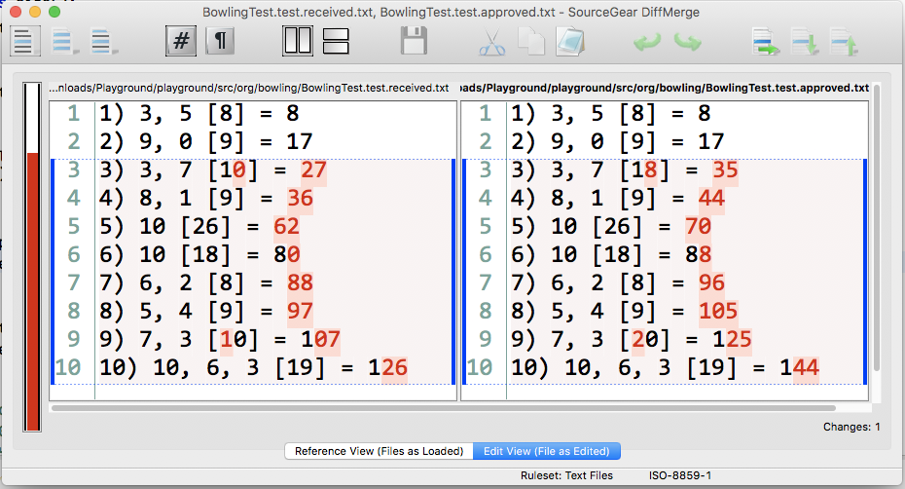
ApprovalTests
ApprovalTests is a Free & Open Source Verification Library
SPARE IS SCORING WRONG

Slide 66
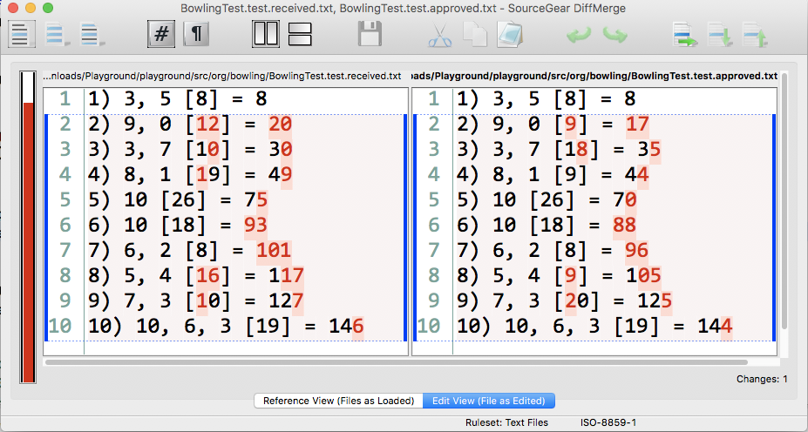
ApprovalTests
ApprovalTests is a Free & Open Source Verification Library
SPARE DETECTED WRONG

Slide 67
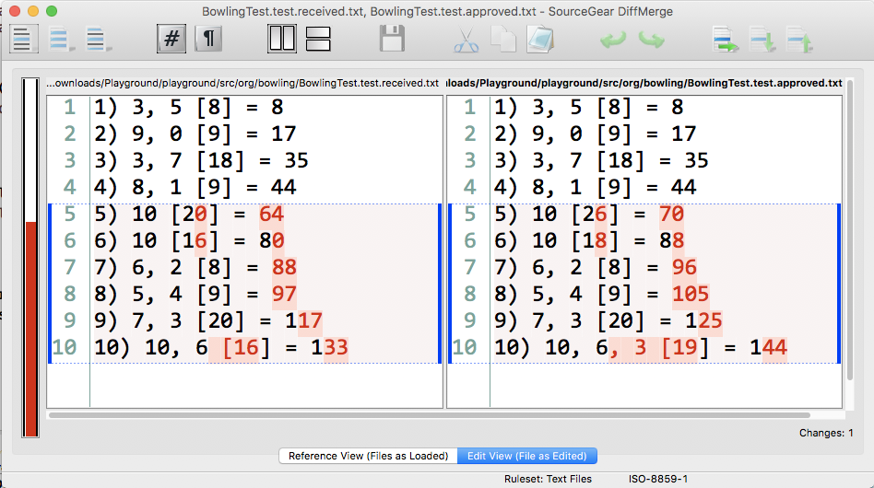
ApprovalTests
ApprovalTests is a Free & Open Source Verification Library
STRIKE IS SCORING WRONG

Slide 68
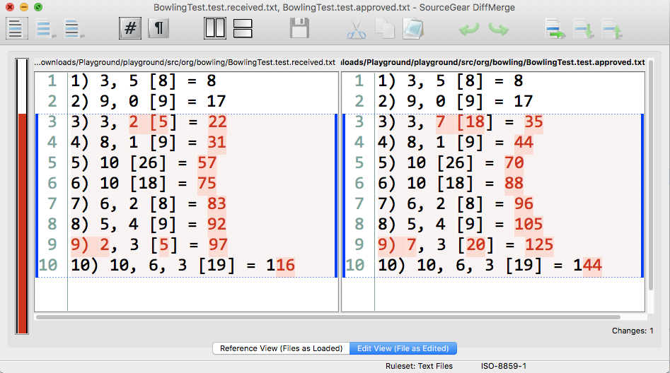
ApprovalTests
ApprovalTests is a Free & Open Source Verification Library
7’s SEEN AS 2’s

Slide 69
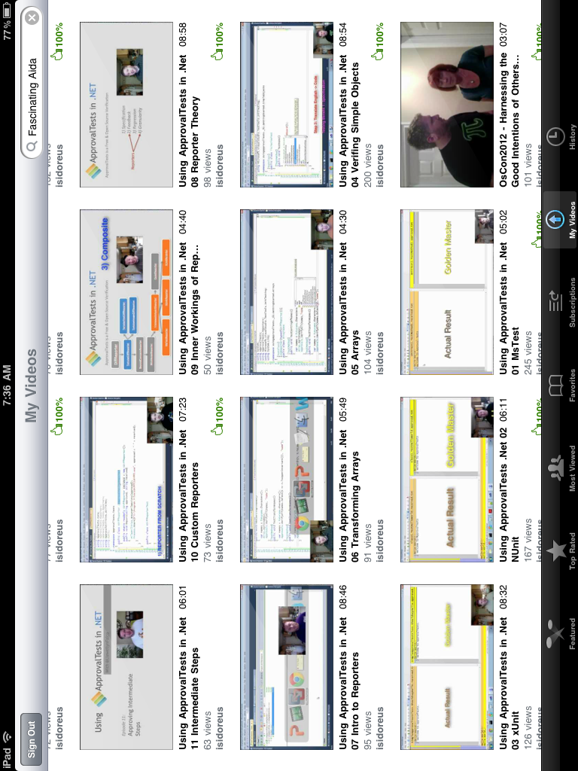
www.ApprovalTests.com
21 episode YouTube series
Notes:
Both

Slide 70

Thank YOU (Please connect via linkedin and twitter)
@LlewellynFalco
youtube.com/isidoreus
LlewellynFalco.Blogspot.com approvaltests.com

Slide 71
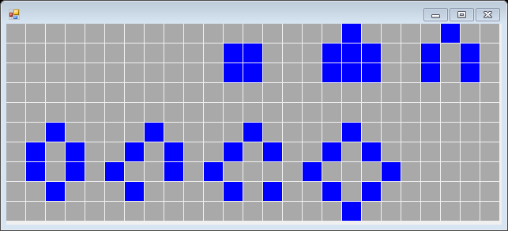
ApprovalTests in .Net
ApprovalTests is a Free & Open Source Verification
GameOfLifeTest.cs
GameOfLifeTest.cs
[TestMethod]
public void TestAll()
{
var game = new Board(25, 10);
PlaceCells(game);
game.AdvanceTurn();
Approvals.Verify(game.ToString());
}
[TestMethod]
public void TestAllGui()
{
var game = new Board(25, 10);
PlaceCells(game);
game.AdvanceTurn();
Form gui = new GameOfLifeGui(game);
WinFormsApprovals.Verify(gui);
}
+
+
0 1 2 3 4 5 6 7 8 9 10 11 12 13 14 15 16 17 18 19 20 21 22 23 24
0 * *
1 * * * * * * *
2 * * * * * * *
3
4
5 * * * *
6 * * * * * * * *
7 * * * * * * *
8 * * * * * *
9 *
GameOfLifeTest.TestAll.approved.txt
GameOfLifeTest.TestAll.approved.png

Slide 72
ApprovalTests
ApprovalTests is a Free & Open Source Verification
ApprovalTests
1) Specification
2) Feedback
3) Regression
4) Granularity
Reporters

Slide 73
ApprovalTests in .NET
ApprovalTests is a Free & Open Source Verification
Do
Verify
Pass
Slow
Increase
Feedback
Fail

Slide 74
ApprovalTests in .NET
ApprovalTests is a Free & Open Source Verification
Approvals.Verify(“Hello World”);
received
approved

